Slide 1
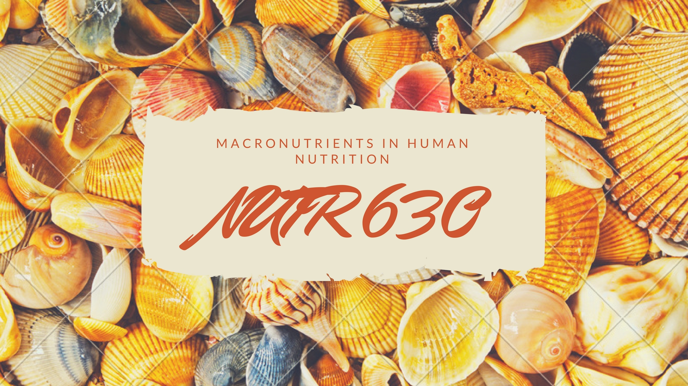

Slide 2
On the board
Using the handout, rank those foods from ”best” (1) to “worst” (2)
Set your iClicker to AB
Hold power for 2 seconds
Press A, B
Should see flashing red lights

Slide 3
Objectives
Learn about the instructors
Overview of Gameful Learning Theory and GradeCraft platform by Evan Straub
Review elements of course
Distinguish between required and optional assignments
Discuss purpose of iClicker quizzes
Take concept inventory
Discuss energetics versus dispensability

Slide 4
Who are we?
Dr. Liv Anderson, Clinical Assistant Professor
Will teach most of the digestion lectures
Dr. Dave Bridges, Assistant Professor
Will teach most of the metabolism lectures
Rina Hisamatsu, GSI
Will run review sessions
Will teach the gluconeogenesis lecture
Notes:
Should be at minute 10 here.

Slide 5
Who are you?
Results of student onboarding survey

Slide 6
Food Rankings
Discuss your food rankings in groups of 5-6
Briefly Introduce yourself to the others in the group
Decide on group rankings (take about 10 mins)
Feedback
What are some criteria that your group used to define “good”
What food was the most controversial?
Notes:
Start this at 1:45

Slide 7
What food is healthy?
Percent of nutritionists
saying a food is healthy
Taken from the New York Times Upshot article from July 5, 2016.
https://www.nytimes.com/interactive/2016/07/05/upshot/is-sushi-healthy-what-about-granola-where-americans-and-nutritionists-disagree.html
Percent of all Americans
saying a food is healthy

Slide 8
Course Goals
Develop in-depth understanding of digestive tract anatomy and process of digestion, absorption and transportation mechanisms
Macronutrient (carbohydrates, proteins, lipids)
Describe structure and properties
Describe digestion, absorption, transportation
Explain human metabolism
Understand inter-organ mechanisms
Understand water and electrolyte distribution
Notes:
Bulk of course focuses on 3 macronutrients

Slide 9
Technology in the Classroom
Strict technology policy. To eliminate screen time distractions, please no use of:
Laptops
Tablets
Smart phones
Slides will be printed out and distributed at the beginning of class
Notes:
Keep you on task - avoid distracting others around you
I will print lectures each time for you.

Slide 10
iClickers
Purchase and register iClickers
UM Computer Showcase
Buy new or used
Details on syllabus, must register
Utilization of clickers in class include:
Quizzes on required readings
Topic reflections and reviews
Notes:
Quizzes – starting next week at the beginning of each class period to make sure keeping up with reading
Support class discussion and make sure understanding material – not graded but part of participation

Slide 11
The easiest quiz
Press A

Slide 12
Assignments
Required assignments are meant to assess foundational knowledge. These include
Midterms
Quizzes
In-class assignments
Optional assignments
Demonstration of Foundational Knowledge | Written Communication | Oral Communication | Peer Interaction
Midterms | Written Report | In-Class Presentation | In-Class Assignments
Quizzes | Public Writing |  | News Topic
Review Questions | Social Media |  | News Discussion
Problem Roulette |  |  | Peer Grading of Presentation
 |  |  | Presentation Discussion
Notes:
Review Qs submitted on canvas
Describe review session

Slide 13
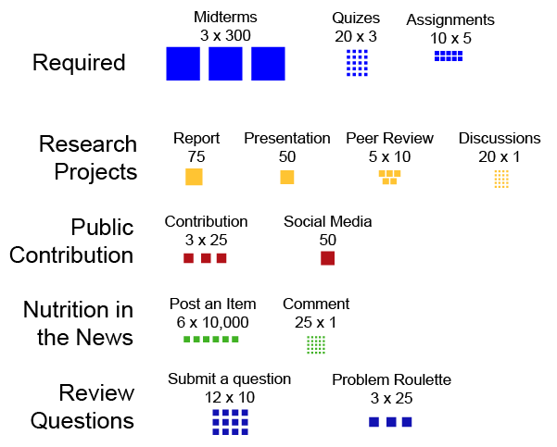
Optional Assignments
Pick and choose based on what is meaningful and effective to your learning
Take risks!
Notes:
Review Qs submitted on canvas
Describe review session

Slide 14
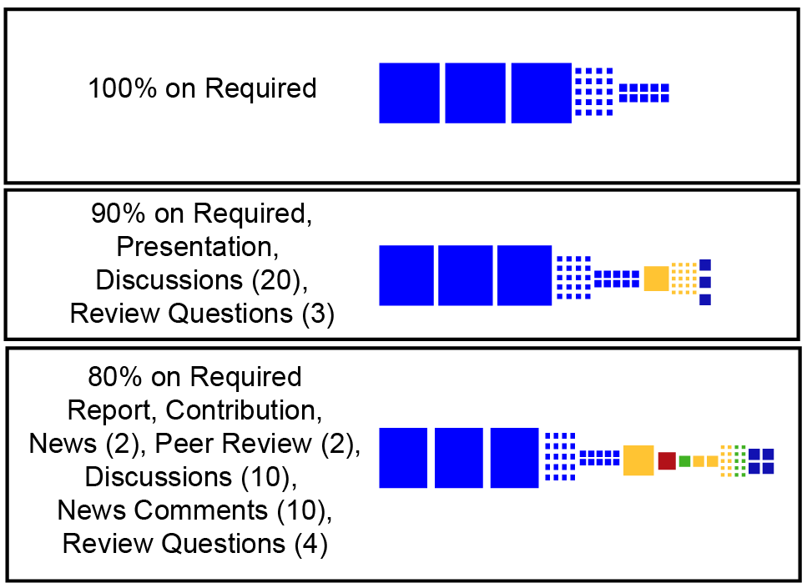
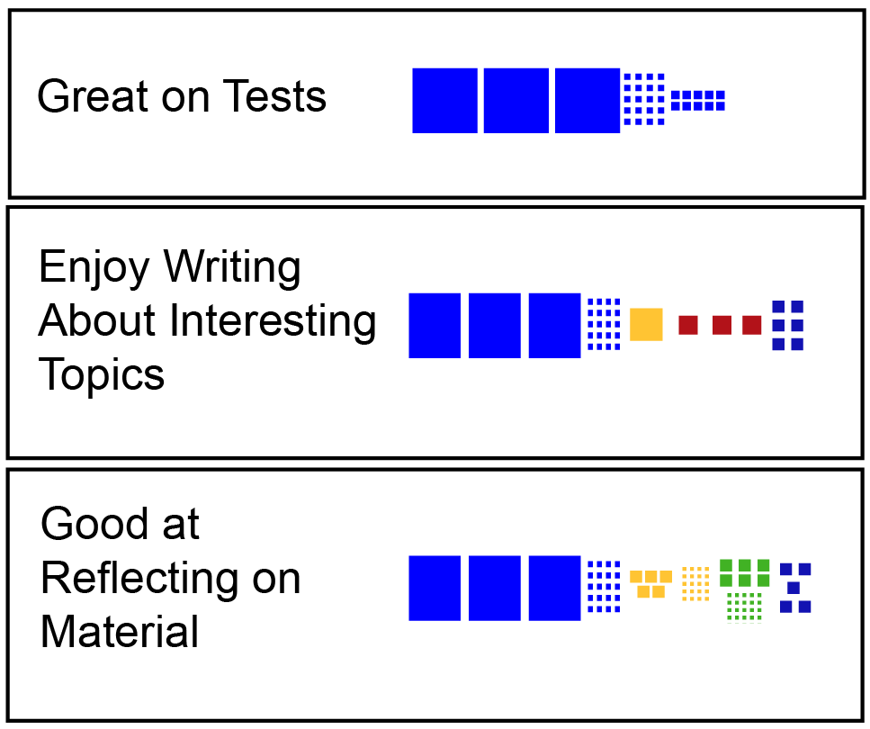
Levels and Grades
1000 points to get an A
Many routes to get to 1000 points
Notes:
Have Rina

Slide 15
General Advice
Read the summaries of the assignments and think about how you want to do
Use Grade Predictor to plan out how and when to do these assignments
Leave some room to take a risk and if needed try something else

Slide 16
Gameful Learning Pedagogy
For intrinsic motivation students need to
Make meaningful choices
Be challenged but be able to succeed
Feel connected to those around them
Game concepts
Choices
Freedom to fail
Recurrent feedback
Transparency of progress

Slide 17
Differences with Traditional Classes
Normal
Start with 100% only down from there
All students take same path of assessments
Instructor picks due dates
Gameful
Gain points towards grade
Students pick their own path (but some assignments are required)
Students choose when to do assignments

Slide 18
Making Use of the Handouts
Read the required readings
Canvas is where readings are posted
Also lists extra information, videos, optional assignments
Give yourself some time to identify what is clear and what is unclear
Ask the instructional team extra materials if you need them
Vocabulary issues
Review the materials after class
Write multiple choice review questions (Optional assignment)

Slide 19
Make this class your own
Pick a path that is best for you
Work with study groups
Reach out to the instructional team

Slide 20
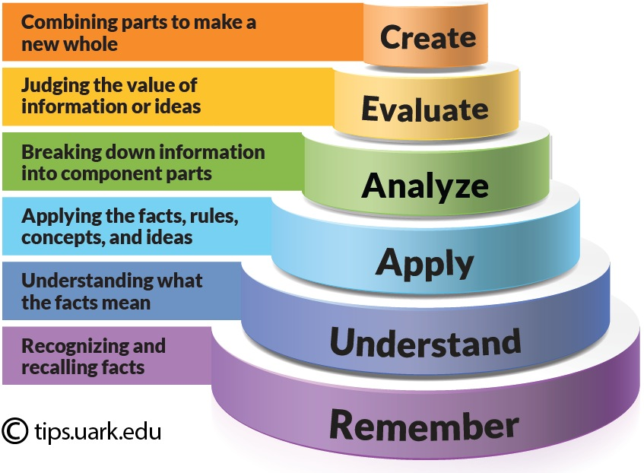
Bloom’s Taxonomy
Notes:
Example: Need to understand what an enzyme is and does, if you want to apply it to a case where say lipids are not being absorbed – perhaps there is a deficiency in a lipid enzyme in the digestive tract.
Need to provide examples of MC questions at varying levels of Bloom’s

Slide 21
Syllabus: Course Assessments
Patient DMC has chief complaint of a sour/acidy taste in their mouth. What is the cause?
Bicarbonate from pancreatic juice has refluxed back towards the mouth
HCl from the stomach has refluxed back to the mouth due to incomplete closure of a sphincter
Food has been lodged in the esophagus for an extended period of time stimulating acid production
DMC has a lipid digestive enzyme deficiency resulting in fats refluxing back to the mouth
Notes:
Material building upon itself: In order to apply one concept to another you need to understand the topics.

Slide 22
Concept Inventory
Notes:
10- 15 minutes

Slide 23
Essential Nutrients
What can we make ourselves?
What cant we make at all?
What can we make but not enough when needed?
How do individuals vary in terms of requirements
Vitamins and Minerals will largely be covered in NUTR631 next semester

Slide 24
Which of these macronutrients can we make ourselves and do not need from the diet?
Alanine
Lysine
Omega 6 Fatty acids
Vitamin D

Slide 25
Energy and Efficiency
Macronutrients provide energy
Efficiency and energy balance
Is inefficiency good or bad
Efficiency of digestion
Energy used in storage/release
Futile cycles

